Slide 1
Business Analyst customer exp
August 8, 2025

Slide 2
Agenda
Assumptions Impact Assessment Behavioral Trends Tenure vs. Proficiency Self-Perception vs Reality Pre vs Post Comparison Areas for Improvement Recommendations

Slide 3
Assumptions: Choosing the Right Statistical Test
Step 2
Step 4
Identify Non-Normal Data
Check for Outliers
If the assumption of normality is violated, use the Mann-Whitney U test instead of the t-test.
Significant outliers can skew t-test results; Mann-Whitney U is less sensitive to extreme values.
Step 1
Step 3
Step 5
Assess Data Normality
Evaluate Ordinal Data
Select Statistical Test
Use the Shapiro-Wilk Normality Test to determine if data is normally distributed.
For data measured on an ordinal scale, such as rankings or satisfaction ratings, the Mann-Whitney U test is preferred.
Based on the assessment of normality, data scale, and outliers, choose the most appropriate statistical test for your analysis.

Slide 4
Setup and Data
Implementation Date
CSAT _Data
Self-Audit_Data
The key date for the analysis is March 8, 2024, which marks the implementation point to separate pre- and post- data periods for comparison.
Customer Satisfaction (CSAT) data is loaded from 'csat_data.csv' with response dates parsed as the index, providing time-series data on CSAT counts before and after implementation.
Self-audit data is loaded from 'self_audit_data.csv' with dates parsed as the index, capturing detailed agent behavioral scores over time used for trend and correlation analysis.

Slide 5
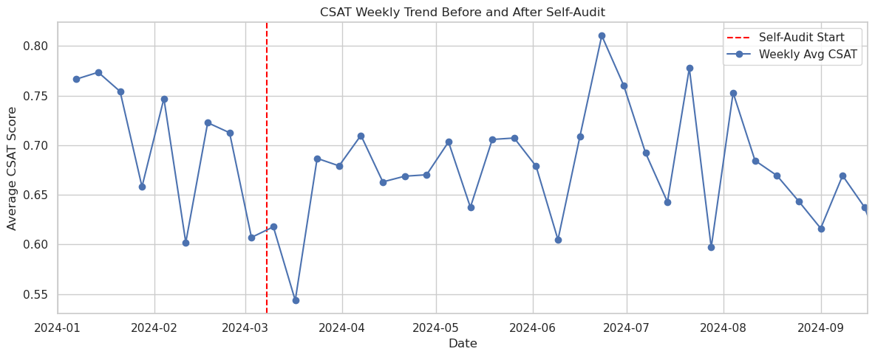
Impact test

Slide 6
IMPACT ASSESSMENT (CSAT PRE VS. POST)
Impact test
Objective: To determine if CSAT scores improved after the implementation of the self-assessment form.
Since both groups failed the normality test (p-values below 0.05), a non-parametric Mann-Whitney U test was used instead of a t-test. Test result P-Value=0.1871, indicating no statistically significant impact on CSAT counts after implementation.

Slide 7
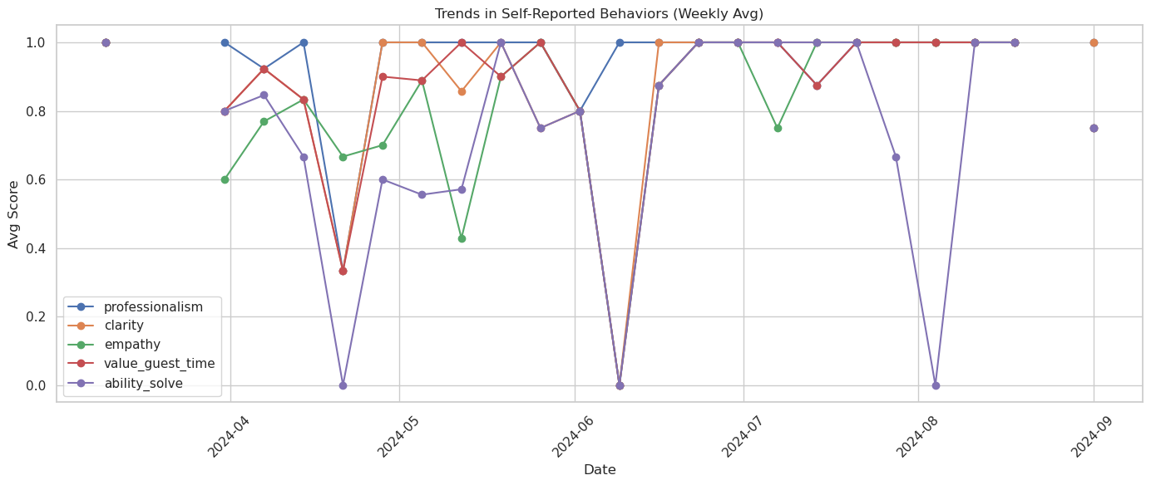
Behavioral Analysis

Slide 8
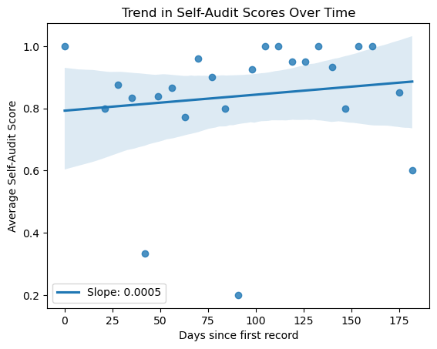
Behavioral Trends Analysis
Behavioral Analysis
Objective: To analyze if there is an improvement in the agent behaviors evaluated in the form over time. Self-audit scores were aggregated weekly and averaged across several behavioral metrics: professionalism, clarity, empathy, value of guest time, and ability to solve issues. Result: Regression p-value = 0.5435, indicating no statistically significant trend.

Slide 9
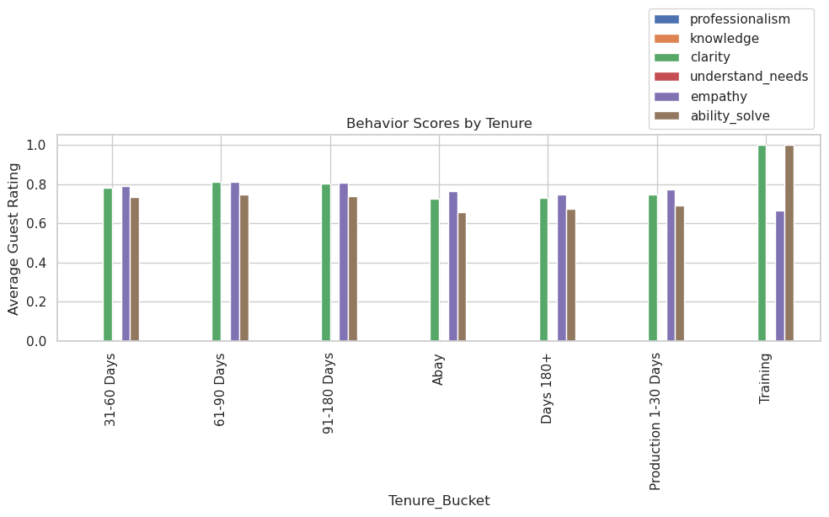
Correlation Analysis

Slide 10
Tenure vs. Proficiency Correlation
Correlation
Objective: To understand the relationship between an agent's tenure at the company and their proficiency (self-assessment scores). Tenure and proficiency data were merged by agent name to analyze the relationship.
Spearman correlation coefficient was used due to ordinal nature of tenure buckets. Calculated Spearman correlation: -0.137, p-value: 0.4313, indicating no significant correlation.

Slide 11
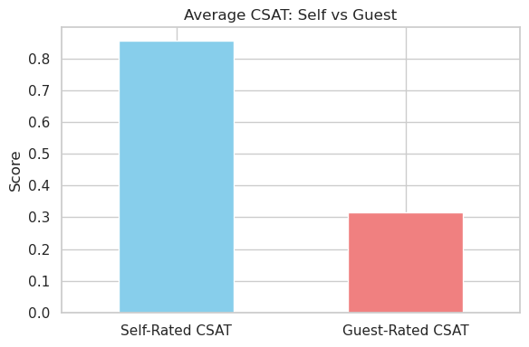
Correlation

Slide 12
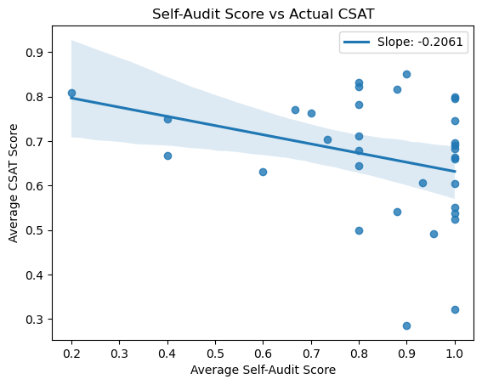
Self-Perception vs. Reality
Correlation
Objective: To compare the proficiency an agent perceives having with the actual CSAT scores they receive.
Grouped data shows average self-audit and CSAT scores per agent. Pearson correlation between self-audit scores and CSAT scores is -0.300 with p=0.0903, indicating a negative but not statistically significant relationship.

Slide 13
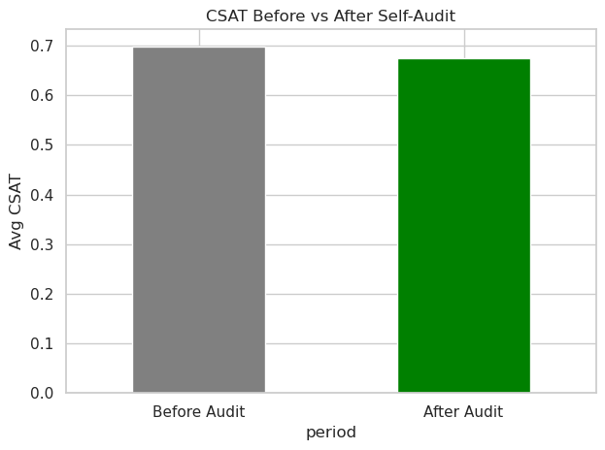
Pre vs. Post Implementation
Impact test
The lack of correlation between self-perception and customer reality is the most critical issue.
The self-assessment form has not had a statistically significant impact on CSAT performance. Normality tests indicated non-normal distribution, leading to the use of the Mann-Whitney U test. The Mann-Whitney U test statistic was 1,651,693.500 with a p-value of 0.1871.

Slide 14




Areas for Improvement
Use specific examples or case studies from your organization to illustrate the impact of improving these behavioral areas on customer satisfaction.
Empathy
This behavior shows a negative correlation (-0.170) with CSAT scores, suggesting it is a critical area where enhancing agents' empathetic interactions could improve customer satisfaction.
Professionalism
Professionalism also has a negative correlation (-0.192) with CSAT, indicating a need to strengthen agents' professional conduct to positively impact customer feedback.
Valuing Guest Time
This metric shows the strongest negative correlation (-0.212) to CSAT scores among the behaviors assessed. Improving how agents value and manage guest time is essential for better customer experiences.

Slide 15
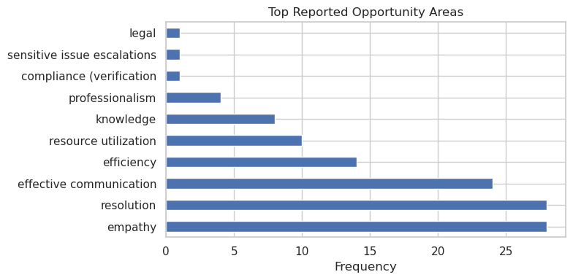
Improvement

Slide 16
conclussions
Statistical tests indicate NOT causal significant change in CSAT scores.
Correlations show no meaningful relationship between an agent's self-perceived proficiency and their actual CSAT scores.
program is not effectively driving agent improvement, and a new strategy is needed to align agent self-perception with customer experience to improve CSAT.

Slide 17
Recommendations
Increase self-audit coverage across all agents for a more representative sample to improve data reliability. Align self-audit scoring scale with CSAT to reduce bias and ensure consistency between self-assessments and customer feedback. Collect post-interaction customer feedback linked directly to the same audited interaction to strengthen the connection between self-audit scores and actual customer satisfaction. These steps will help create a more accurate evaluation framework and better support agent development and customer experience improvements.

Slide 18
¡ Thank you !
Thank you

